Slide 1

Report
By
2nd year Int. M.Tech Applied Geophysics
Indian Institute of Technology (Indian School of Mines) DHANBAD
Email: agpism2018@gmail.com

Slide 2
List of Experiments
Analysis of Equivalents Uranium contents in Powder Sample.
Statistical Analysis in nuclear measurements.
Attenuation coefficient (Intensity Vs Distance).
GM Plateau analysis, Thresh voltage, OP voltage and Breakdown voltage.
Dependency of gamma count rate on weight of Sample.
Calibration of Secondary Standard with GM counter using Primary Standard.
Natural Gamma ray logging for estimation of equivalent Uranium.

Slide 3
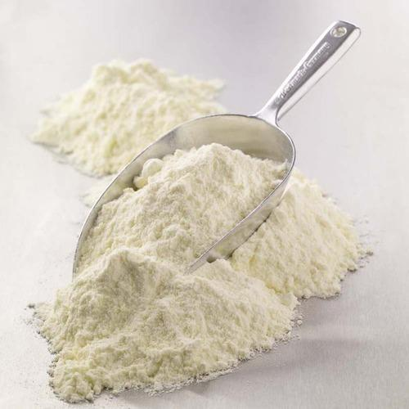
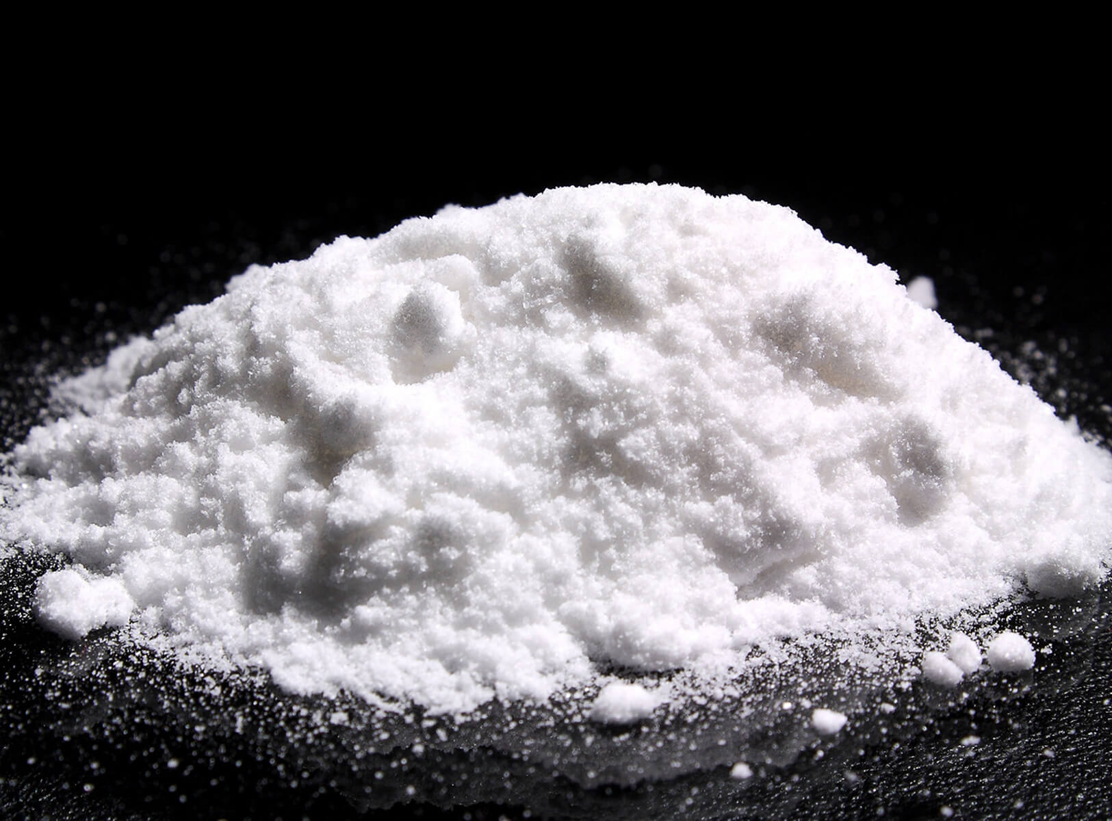
Analysis of Equivalents Uranium contents in Powder Sample.
Background Count | Standard count(35g) | Sample count for 35g
140 | 699 | 317
137 | 689 | 275
154 | 676 | 282
139 | 680 | 281
144 | 681 | 311
Average 142.8 | 685 | 293.2
G₁ /C₁ = G₂ /C₂
G₁ = 0.06 C₁ = 542 C₂ = 150
Solving,
G₂ = 0.0166
∵ 1 Ton of sample contains 166 g of Uranium
∴ In 35g of sample = 5.81 milligrams

Slide 4
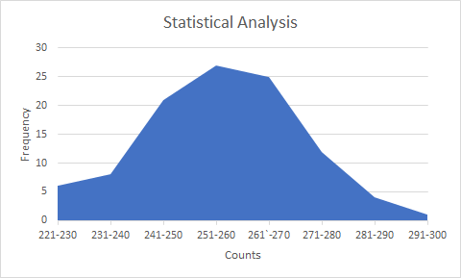
2. Statistical Analysis in nuclear measurements.
Interval | 221-229 | 231-239 | 241-249 |  | 251-259 |  | 261-269 |  | 271-279 | 281-289 | 291-299
Frequency | 6 | 8 | 21 |  | 27 |  | 25 |  | 12 | 4 | 1
 | 221 | 233 | 241 | 246 | 251 | 254 | 261 | 265 | 271 | 282 | 291
 | 222 | 238 | 242 | 246 | 251 | 255 | 261 | 266 | 272 | 284
 | 222 | 239 | 242 | 247 | 251 | 256 | 261 | 266 | 273 | 287
 | 223 | 239 | 242 | 247 | 252 | 256 | 261 | 266 | 273 | 290
 | 229 | 240 | 243 | 247 | 252 | 257 | 262 | 266 | 274
 | 229 | 240 | 244 | 248 | 252 | 257 | 263 | 267 | 274
 |  | 240 | 245 | 248 | 253 | 258 | 263 | 267 | 274
 |  | 240 | 246 | 248 | 253 | 258 | 263 | 268 | 275
 |  |  | 246 | 249 | 253 | 258 | 264 | 269 | 277
 |  |  | 246 | 249 | 253 | 259 | 264 | 269 | 278
 |  |  |  | 250 | 254 | 259 | 264 | 270 | 278
 |  |  |  |  | 254 | 260 | 265 | 270 | 280
 |  |  |  |  | 254 | 260 |  | 270
 |  |  |  |  |  | 260

Slide 5
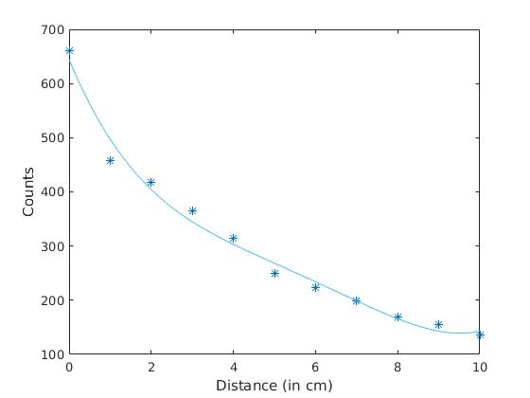
3. Attenuation coefficient (Intensity Vs Distance).
Distance (in cm) | Counts per 50s
0 | 660
1 | 458
2 | 417
3 | 365
4 | 315
5 | 250
6 | 224
7 | 198
8 | 169
9 | 155
10 | 136

Slide 6
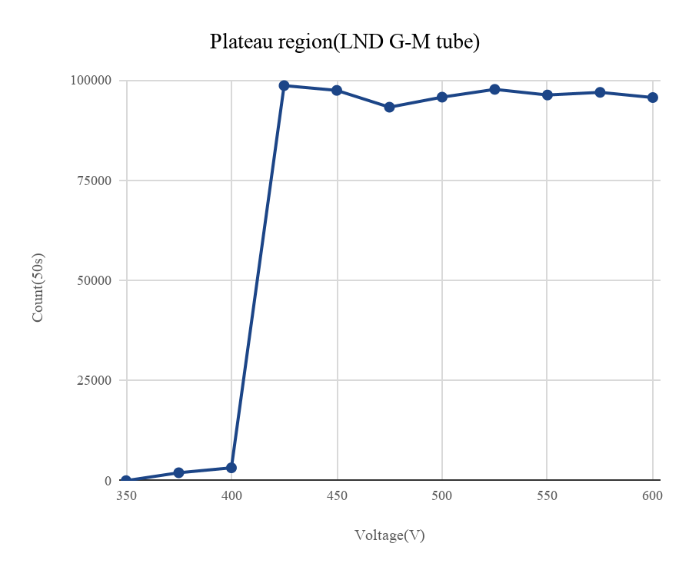
4. GM Plateau analysis, Thresh voltage, OP voltage and Breakdown voltage.
Voltage | Counts per 50s
350 | 0
375 | 1970
400 | 3203
425 | 98617
450 | 97422
475 | 93229
500 | 95734
525 | 97676
550 | 96269
575 | 96932
600 | 95635

Slide 7
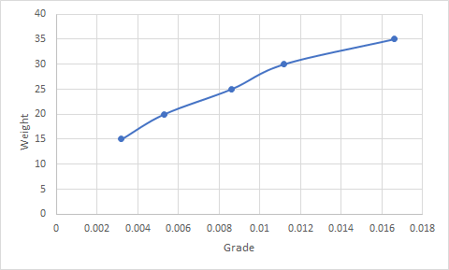
5. Dependency of gamma count rate on weight of Sample.
Background count | Standard count | Sample count for 35g | Sample count for 30g | Sample count for 25g | Sample count for 20g | Sample count for 15g
140 | 699 | 317 | 255 | 240 | 253 | 200
137 | 689 | 275 | 260 | 254 | 222 | 208
154 | 676 | 282 | 236 | 271 | 215 | 220
139 | 680 | 281 | 277 | 252 | 230 | 200
144 | 681 | 311 | 281 | 243 | 218 | 227
Average 142.8 | 685 | 293.2 | 261.8 | 252 | 227.6 | 211

Slide 8
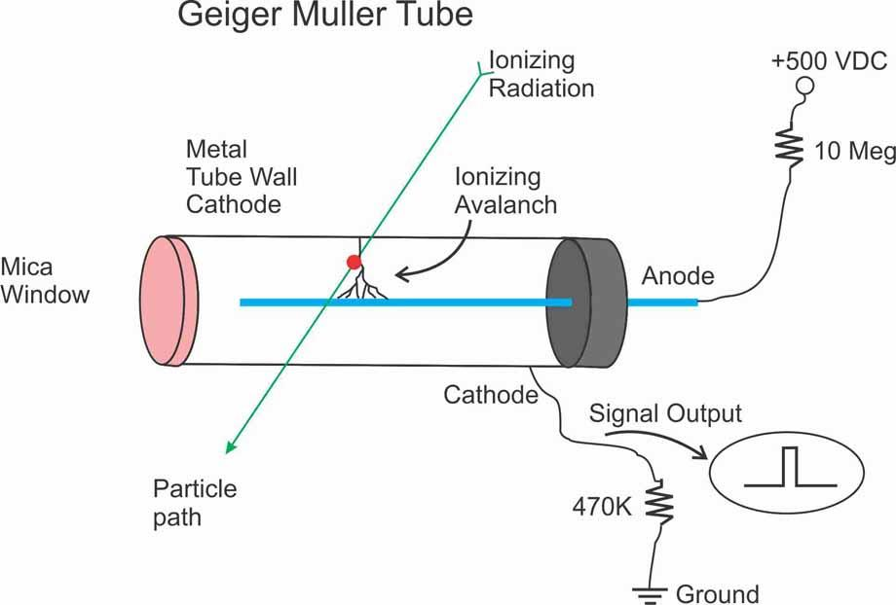
6. Calibration of Secondary Standard with GM counter using Primary Standard.
Background Noise | Primary Std. | Secondary Std.
22 | 146 | 664
14 | 155 | 624
26 | 148 | 627
18 | 131 | 669
28 | 157 | 639
22 | 144 | 625
21 | 158 | 609
28 | 145 | 631
24 | 151 | 650
15 | 143 | 649
31 | 152 | 638
25 | 139 | 643
26 | 135 | 594
20 | 148 | 644
27 | 137 | 644
21 | 138 | 650
29 | 161 | 653
22 | 149 | 622
27 | 158 | 623
26 | 161 | 677
Average 23.6 | 147.8 | 638.75
G₁ /C₁ = G₂ /C₂
G₁ = 0.012 C₁ = 123 C₂ = 615
Solving,
G₂ = 0.060

Slide 9
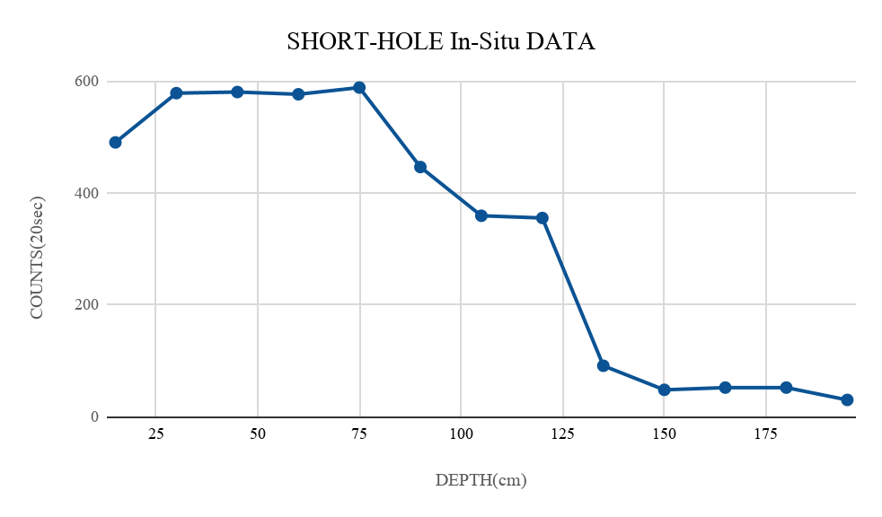
7. Natural Gamma ray logging for estimation of equivalent Uranium.
Depth (in cm) | Counts per 20s
15 | 490
30 | 578
45 | 580
60 | 576
75 | 588
90 | 446
105 | 359
120 | 355
135 | 91
150 | 48
165 | 52
180 | 52
195 | 30

Slide 10
Thank you

